Slide 1
Measuring Internal Product Attributes
Size

Slide 2
Internal Product Attributes
In software engineering, internal product attributes refer to the inherent characteristics of the software codebase and architecture—those aspects that are not directly visible to the end user but impact maintainability, reliability, efficiency, and quality.

Slide 3
Software Size
Size measures only indicate how much of an entity we have.
Size alone cannot directly indicate external attributes such as effort, productivity, and cost
It doesn’t measure the external attributes like “coding difficulties”, however, it is a good measure to predict software development time and resources. e.g.,
Productivity=size/effort
Defect density = Defect count/size

Slide 4
Properties of Valid Software Size Measurement
● Three properties for any valid measure of software size:
Nonnegativity: All systems have nonnegative size.
Null value: The size of a system with no elements is zero.
Additivity: The size of the union of two modules is the sum of the sizes of the two modules after subtracting the size of the intersection
Measure | What it counts | Ignores
LOC | All lines (code + comments) | Nothing
NCLOC | Only actual code lines | Comments & blanks
CLOC | Only comment lines | Code
ES | Each instruction | Comments, declarations

Slide 5
Code Size
The most commonly used measure of source code size is the number of lines of code (LOCs).
We must explain how each of the following is handled:
Blank lines
Comment lines
Data declarations
Lines that contain several separate instructions
One count can be as much as five times larger than another, simply because of the difference in counting technique

Slide 6
LOC Definitions
NCLOC: Non-Commented Lines of Code (Comments and blank lines removed), sometimes called effective lines of a code.
CLOC: Number of comment lines of program text (CLOC)
Total size (LOC) = NCLOC + CLOC
Density of comments = CLOC / LOC
Is NCLOC a valid measure?
The number of executable statements (ES): counts separate statements on the same physical line as distinct. It ignores comment lines, data declarations, and headings

Slide 7
Halstead’s Approach
Halstead’s Software Science is a theoretical approach to measuring software complexity and predicting attributes of a program based on its code
The approach is based on quantifying the properties of a program by examining its operators and operands, aiming to provide objective measures of complexity, size, and effort.
Halstead’s theory is based on four fundamental measures derived from the source code:
µ₁ = Number of unique operators
µ₂ = Number of unique operands
N₁ = Total occurrences of operators
N₂ = Total occurrences of operands
From these basic measures, Halstead derived several important metrics

Slide 8
Halstead’s Approach
Halstead Program Length: The total number of operator occurrences and the total number of operand occurrences. N = N₁ + N₂
Estimated program length is, N^ = µ₁log₂µ₁ + µ₂log₂µ₂
Halstead Vocabulary: µ = µ₁ + µ₂
Program Volume: V = Size * (log₂ vocabulary) = N * log₂(µ)
Program Difficulty: D = (µ₁ / 2) * (N₂ / µ₂)
Programming Effort: E = D * V = Difficulty * Volume
Programming Time (T) = E/18

Slide 9
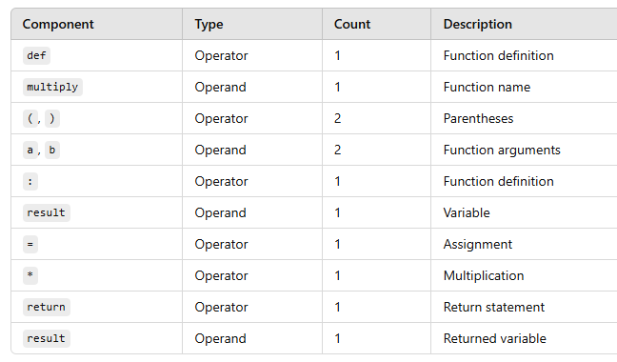
Halstead’s Approach Example
def multiply(a, b):
result = a * b
return result;

Slide 10
Halstead’s Approach Example
Metric | Value | Formula / Explanation
µ₁ (Distinct operators) | 5 | (6)??? | def, (), :, =, *, return
µ₂ (Distinct operands) | 4 | multiply, a, b, result
N₁ (Total operators) | 7 | def, (), :, =, *, return, ()
N₂ (Total operands) | 5 | multiply, a, b, result, result

Slide 11
Insight
Low Program Difficulty (D): Indicates that the code is relatively easy to understand and modify.
Effort (E) and Programming Time (T) are also low, reflecting the simplicity of the program.
Volume (V) is moderate, as the program is small and straightforward.
Cyclomatic Complexity??
Code Smells?
Code Duplications?

Slide 12
Alternative Size Measures
We can measure the size in terms of
Number of bytes of computer storage
Number of characters in the program text

Slide 13
Design Size
Count design elements rather than LOCs
Appropriate size measure depends on the design methodology, the artifacts developed, and the level of abstraction
To measure the size of a procedural design, you can count the number of procedures and functions at the lowest level of abstraction
At higher levels of abstraction, you can count the number of packages and subsystems. You can measure the size of a package or subsystem in terms of the number of functions and procedures in the package.

Slide 14
Design Size
Object-oriented designs add new abstraction mechanisms: objects, classes, interfaces, operations, methods, associations, inheritance, etc.
Thus, we will measure the size in terms of packages, design patterns, classes, interfaces, abstract classes, operations, and methods.
Packages: Number of sub packages, number of classes, interfaces (Java), or abstract classes (C++)
Design patterns:
Number of different design patterns used in a design
Number of design pattern realizations for each pattern type
Number of classes, interfaces, or abstract classes that play roles in each pattern realization
Classes, interfaces, or abstract classes: Number of public methods or operations, number of attributes
Methods or operations: Number of parameters, number of overloaded versions of a method or operation

Slide 15
Design Size
Weighted Methods per Class (WMC) measure: measured by summing the weights of the methods in a class, where weights are unspecified complexity factors for each method
Both the number of methods and the number of attributes can serve as class size measures
One set of studies found that the number of methods is a better predictor of class change-proneness than the number of attributes

Slide 16
Requirement Analysis and Specification Size
Requirement and specification documents combine text, graphs, and special mathematical diagrams and symbols.
It may not be easy to generate a single-size measure because a requirement analysis often consists of a mix of document types.
For example, a use case analysis may consist of a UML use case diagram along with a set of use case scenarios that may be expressed as either text or as UML activity diagrams

Slide 17
Cost of a Project
The cost of a project is due to:
The requirements for software, hardware, and human resources
The cost of software development is due to the human resources needed
Most cost estimates are measured in person-months (PM)

Slide 18
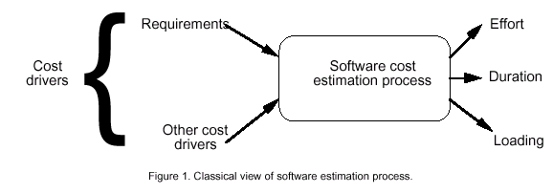
Software Cost Estimation

Slide 19
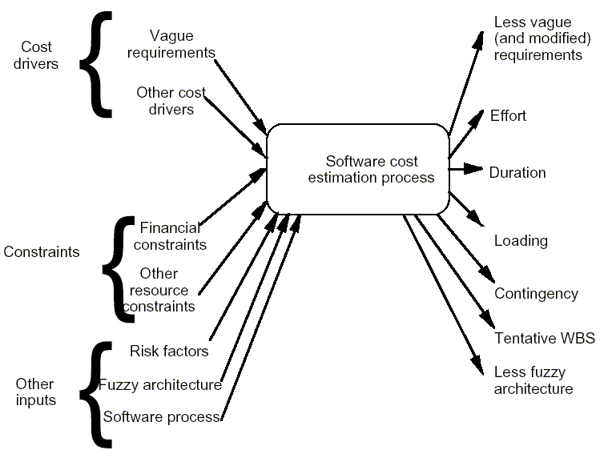
Actual View

Slide 20
Effort ( using LOC)
Effort Equation
PM = a * (KDSI)^{b} (person-months)
where PM = number of person-month (=152 working hours),
a = a constant,
KDSI = thousands of "delivered source instructions" (DSI) and
b = a constant.

Slide 21
Productivity
Productivity equation
(DSI) / (PM)
where PM = number of person-month (=152 working hours),
DSI = "delivered source instructions"

Slide 22
Schedule and Average Staffing
Schedule equation
TDEV = c * (PM)^{d} (months)
where TDEV = number of months estimated for software development.
Average Staffing Equation
(PM) / (TDEV) (FSP)
where FSP means Full-time-equivalent Software Personnel.

Slide 23
Cost Estimation Process
Effort
Size Table
Lines of Code
Number of Use Case
Function Point
Development Time
Estimation Process
Number of Personnel
Errors

Slide 24
Project Size - Metrics
Number of functional requirements
Cumulative number of functional and non-functional requirements
Number of Customer Test Cases
Number of ‘typical sized’ use cases
Number of inquiries
Number of files accessed (external, internal, master)
Total number of components (subsystems, modules, procedures, routines, classes, methods)
Total number of interfaces
Number of System Integration Test Cases
Number of input and output parameters (summed over each interface)
Number of Designer Unit Test Cases
Number of decisions (if, case statements) summed over each routine or method
Lines of Code, summed over each routine or method

Slide 25
Project Size - Metrics
Availability of Size Estimation Metrics:
Development Phase
Available
Metrics
a
Requirements Gathering
1, 2, 3
b
Requirements Analysis
4, 5
d
High Level Design
6, 7, 8, 9
e
Detailed Design
10, 11, 12
f
Implementation
12, 13

Slide 26
Function Points
Function Point (FP) is a software size estimation technique used to measure the functionality delivered by a system, independent of the programming language, tools, or technology used.
A function point calculates software size with the help of logical design and performance of functions as per user requirements.
Function Point (FP) is an element of software development that helps to approximate the cost of development early in the process

Slide 27
Function Points Calculation
STEP 1: Measure size in terms of the amount of functionality in a system. Function points are computed by first calculating an unadjusted function point count (UFC). Counts are made for the following categories
External inputs – those items provided by the user that describe distinct application-oriented data (such as file names and menu selections)
External outputs – those items provided to the user that generate distinct application-oriented data (such as reports and messages, rather than the individual components of these)
External inquiries – interactive inputs requiring a response
External files – machine-readable interfaces to other systems
Internal files – logical master files in the system

Slide 28
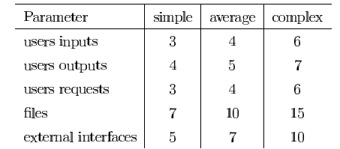
Function Points (cont.)
STEP 2: Multiply each number by a weight factor, according to complexity (simple, average or complex) of the parameter, associated with that number. The value is given by a table:

Slide 29
Function Points (cont.)
STEP 3: Calculate the total UFP (Unadjusted Function Points)
STEP 4: Calculate the total TCF (Technical Complexity Factor) by giving a value between 0 and 5 according to the importance of the following points (next slide):
TCF=0.65+0.01*DI

Slide 30
Function Points (cont.)
Technical Complexity Factors:
Data Communication
Distributed Functions
Performance
Heavily Utilized Hardware
High Transaction Rates
Online Data Entry
Online Updating
End-user Efficiency
Complex Computations
Reusability
Ease of Installation
Ease of Operation
Portability
Maintainability/Facility change
Each component or subfactor is rated from 0 to 5, where 0 means the subfactor is irrelevant, 3 means it is average, and 5 means it is essential to the system being built

Slide 31
Function Points (cont.)
STEP 5: Sum the resulting numbers to obtain DI (degree of influence)
STEP 6: TCF (Technical Complexity Factor) by given by the formula
TCF=0.65+0.01*DI
STEP 6: Function Points are given by the formula
FP=UFP*TCF

Slide 32
Function Points Example

Slide 33
Function Points Example

Slide 34
Function Points Example

Slide 35
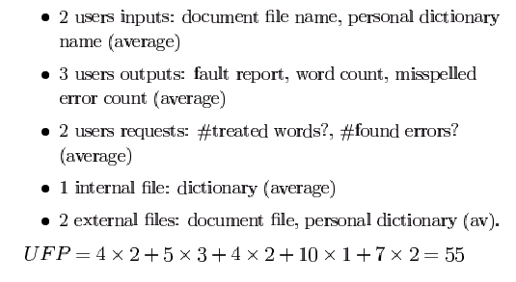
Function Points Example

Slide 36
Function Points Example
Technical Complexity Factors:
F1. Data Communication
F2. Distributed Data Processing
F3. Performance Criteria
F4. Heavily Utilized Hardware
F5. High Transaction Rates
F6. Online Data Entry
F7. Online Updating
F8. End-user Efficiency
F9. Complex Computations
F10. Reusability
F11. Ease of Installation
F12. Ease of Operation
F13. Portability
F14. Maintainability
Each component or subfactor is rated from 0 to 5, where 0 means the subfactor is irrelevant, 3 means it is average, and 5 means it is essential to the system being built.
Sum the resulting numbers to obtain DI (degree of influence)

Slide 37
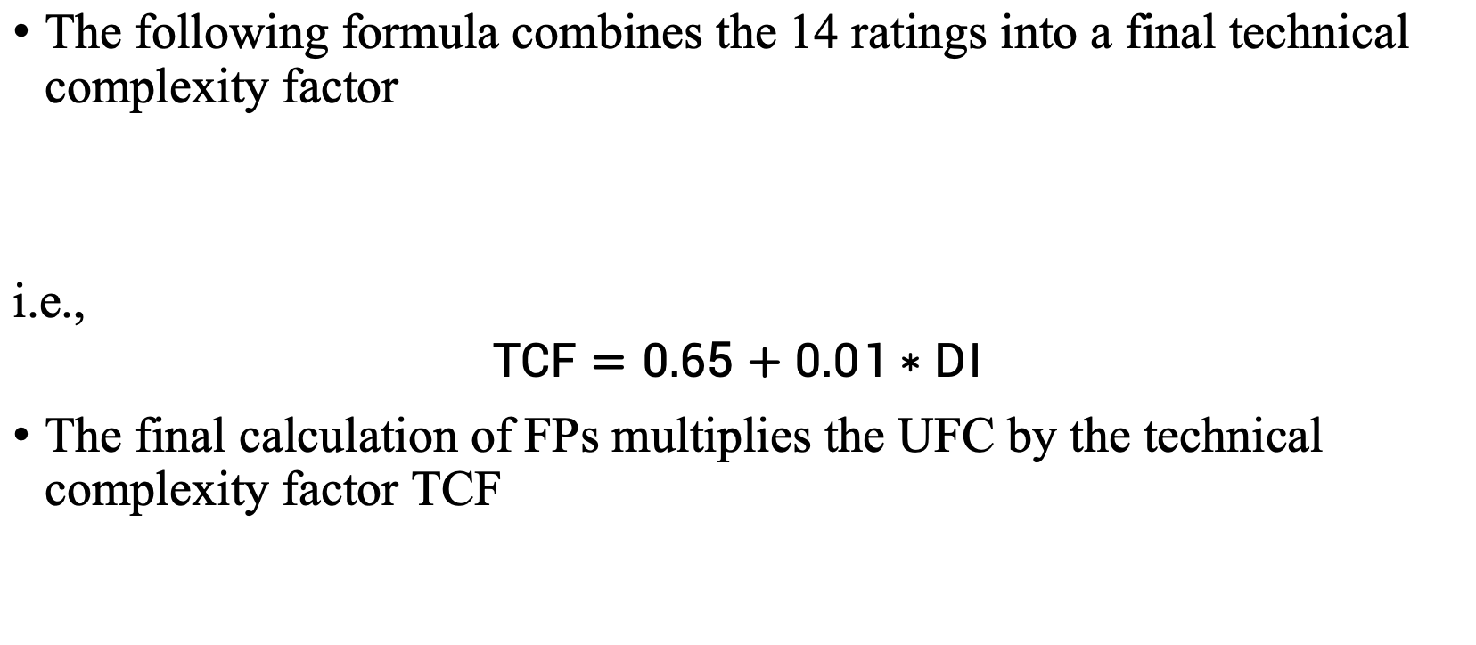
Function Points Example
The following formula combines the 14 ratings into a final technical complexity factor
i.e.,
$$TCF=0.65+0.01∗DI$$
The final calculation of FPs multiplies the UFC by the technical complexity factor TCF

Slide 38
Function Points Example
Function Points
FP=UFP*(0.65+0.01*DI)= 55*(0.65+0.01*30)=52.25
That means FP=52.25
** considering DI or TCF = 30

Slide 39
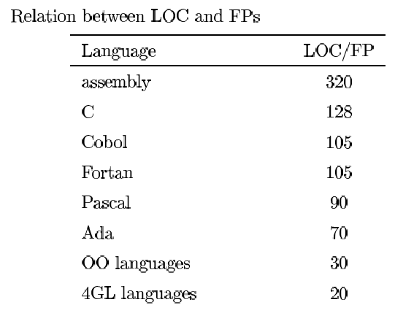
Relation between LOC and FP
Relationship:
LOC = Language Factor * FP
where
LOC (Lines of Code)
FP (Function Points)

Slide 40
Relation between LOC and FP
Assuming LOC’s per FP for:
Java = 53,
C++ = 64
aKLOC = FP * LOC_per_FP / 1000
It means for the SpellChekcer Example: (Java)
LOC=52.25*53=2769.25 LOC or 2.76 KLOC

Slide 41
IFPUG
International Function Point User Group meets regularly to discuss FPs and their applications, and they publish guidelines with counting rules.
Please visit https://ifpug.org/

Slide 42
COCOMO I
COnstructive COst MOdel was introduced by Dr. Barry Boehm
Software projects under COCOMO model strategies are classified into 3 categories, organic, semi-detached, and embedded
Organic: A software project is said to be an organic type if-
Project is small and simple.
Project team is small with prior experience.
The problem is well understood and has been solved in the past.
Requirements of projects are not rigid, such a mode example is payroll processing system.

Slide 43
COCOMO I
Semi-Detached Mode: A software project is said to be a Semi-Detached type if-
Project has complexity.
Project team requires more experience, better guidance, and creativity.
The project has an intermediate size and has mixed rigid requirements such a mode example is a transaction processing system which has fixed requirements.
It also includes the elements of organic mode and embedded mode.
Few such projects are- Database Management System(DBMS), new unknown operating system, difficult inventory management system

Slide 44
COCOMO I
Embedded Mode: A software project is said to be an Embedded mode type if-
A software project has fixed requirements of resources .
Product is developed within very tight constraints.
A software project requiring the highest level of complexity, creativity, and experience requirement fall under this category.
Such mode software requires a larger team size than the other two models.

Slide 45
Types of COCOMO Models
COCOMO consists of a hierarchy of three increasingly detailed and accurate forms. Any of the three forms can be adapted according to our requirements. These are types of COCOMO model:
Basic COCOMO Model
Intermediate COCOMO Model
Detailed COCOMO Model

Slide 46
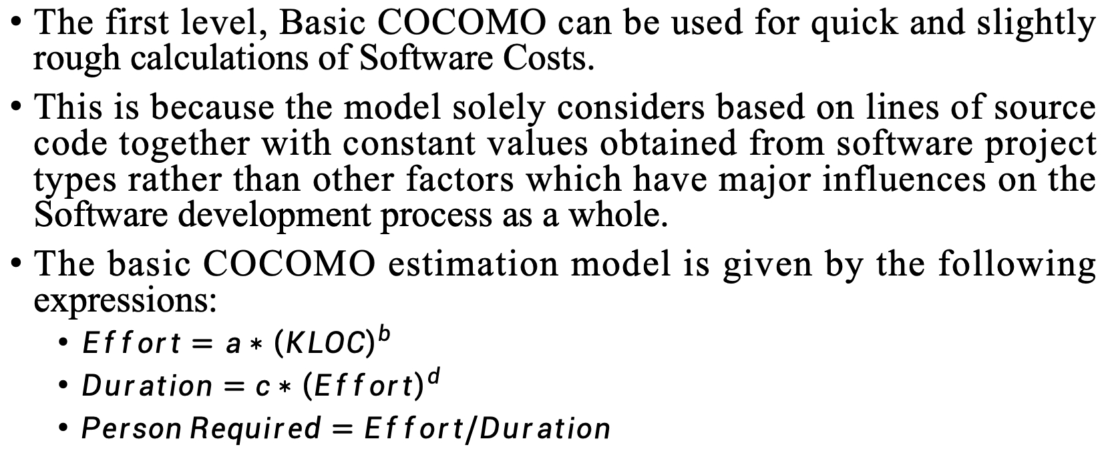
Basic COCOMO Model
The first level, Basic COCOMO can be used for quick and slightly rough calculations of Software Costs.
This is because the model solely considers based on lines of source code together with constant values obtained from software project types rather than other factors which have major influences on the Software development process as a whole.
The basic COCOMO estimation model is given by the following expressions:
$Effort=a∗{\left(KLOC\right)}^{b}$
$Duration=c∗{\left(Effort\right)}^{d}$
$Person Required=Effort/Duration$

Slide 47
Basic COCOMO Model
The values for a, b, c, and d differ depending on which mode you are using
Mode | a | b | c | d
Organic | 2.4 | 1.05 | 2.5 | 0.38
Semi-detached | 3.0 | 1.12 | 2.5 | 0.35
Embedded | 3.6 | 1.20 | 2.5 | 0.32

Slide 48
Basic COCOMO model
Example – Consider a software project using semi-detached mode with 300 Kloc .find out effort estimation, development time, and person estimation.
Solution –
Effort (E) = a*(KLOC)^{b} = 3.0*(300)^{1.12} = 1784.42 PM Development Time (D) = c*(E)^{d} = 2.5(1784.42)^{0.35} = 34.35 Months(M) Person Required (P) = E/D = 1784.42/34.35 = 51.9481 Persons ~52 Persons

Slide 49
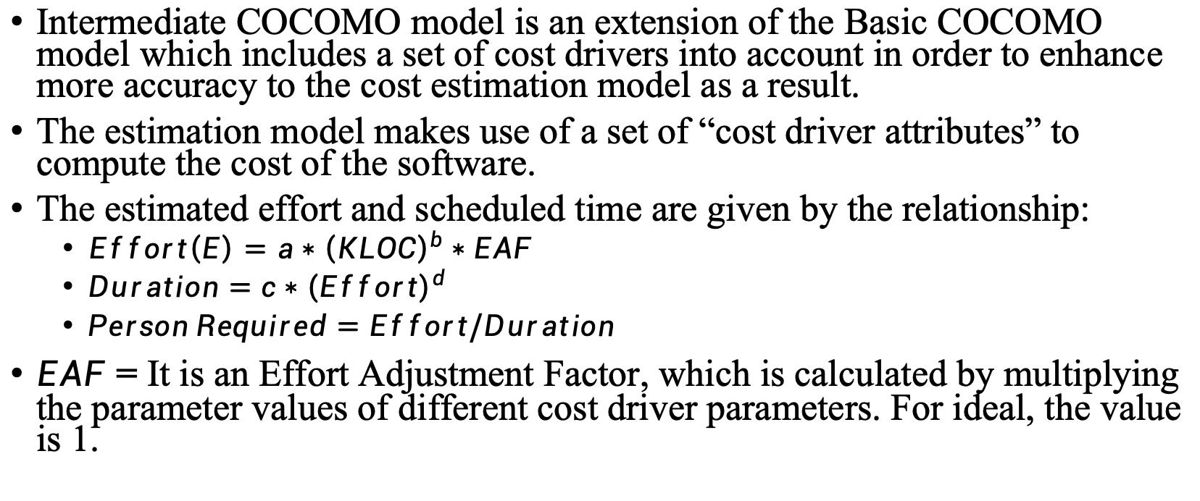
Intermediate COCOMO Model
Intermediate COCOMO model is an extension of the Basic COCOMO model which includes a set of cost drivers into account in order to enhance more accuracy to the cost estimation model as a result.
The estimation model makes use of a set of “cost driver attributes” to compute the cost of the software.
The estimated effort and scheduled time are given by the relationship:
$Effort\left(E\right)=a∗{\left(KLOC\right)}^{b}∗EAF$
$Duration=c∗{\left(Effort\right)}^{d}$
$Person Required=Effort/Duration$
$EAF$ = It is an Effort Adjustment Factor, which is calculated by multiplying the parameter values of different cost driver parameters. For ideal, the value is 1.

Slide 50
Classification of Cost Drivers and their Attributes
Product attributes
Required software reliability extent
Size of the application database
The complexity of the product
Hardware attributes
Run-time performance constraints
Memory constraints
The volatility of the virtual machine environment
Required turnabout time
Personal attributes –
Analyst capability
Software engineering capability
Applications experience
Virtual machine experience
Programming language experience
Project attributes
Use of software tools
Application of software engineering methods
Required development schedule

Slide 51
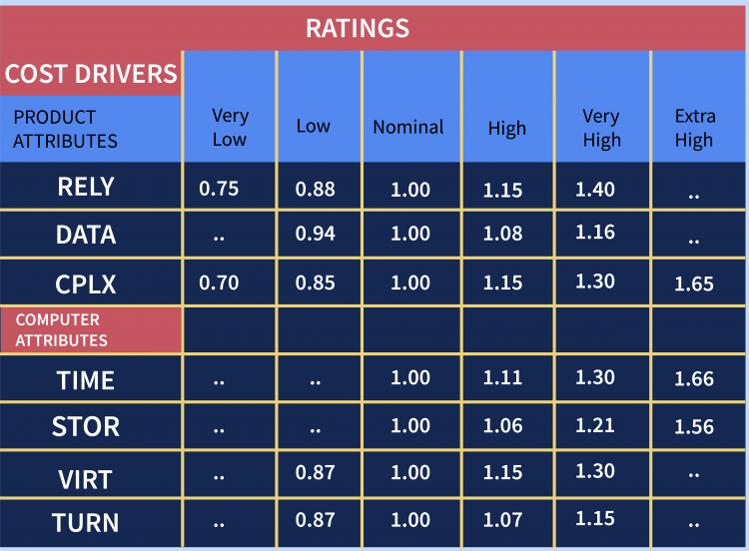
Cost Drivers and Ratings

Slide 52
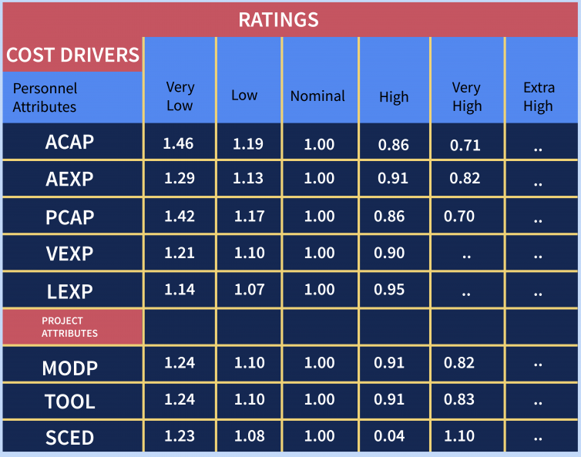
Cost Drivers and Ratings

Slide 53
Cost Drivers and Ratings (Together)
Cost Driver
Very Low
Low
Nominal
High
Very High
Extra High
Required Reliability
.75
.88
1.00
1.15
1.40
1.40
Database Size
.94
.94
1.00
1.08
1.16
1.16
Product Complexity
.70
.85
1.00
1.15
1.30
1.65
Execution Time Constraint
1.00
1.00
1.00
1.11
1.30
1.66
Main Storage Constraint
1.00
1.00
1.00
1.06
1.21
1.56
Virtual Machine Volatility
.87
.87
1.00
1.15
1.30
1.30
Comp Turn Around Time
.87
.87
1.00
1.07
1.15
1.15
Analyst Capability
1.46
1.19
1.00
.86
.71
.71
Application Experience
1.29
1.13
1.00
.91
.82
.82
Programmers Capability
1.42
1.17
1.00
.86
.70
.70
Virtual machine Experience
1.21
1.10
1.00
.90
.90
.90
Language Experience
1.14
1.07
1.00
.95
.95
.95
Modern Prog Practices
1.24
1.10
1.00
.91
.82
.82
SW Tools
1.24
1.10
1.00
.91
.83
.83
Required Dev Schedule
1.23
1.08
1.00
1.04
1.10
1,10

Slide 54
Example
Example: For a given project was estimated with a size of 300 KLOC. Calculate the Effort, Scheduled time for development by considering developer having high application experience and very low experience in programming.
Ans:
Given the estimated size of the project is: 300 KLOC Developer having highly application experience: 0.82 (as per above table) Developer having very low experience in programming: 1.14(as per above table)
EAF = 0.82*1.14 = 0.9348 Effort (E) = a*(KLOC)^{b} *EAF = 3.0*(300)^{1.12} *0.9348 = 1668.07 MM Scheduled Time (D) = c*(E)^{d} = 2.5*(1668.07)^{0.35} = 33.55 Months(M)

Slide 55
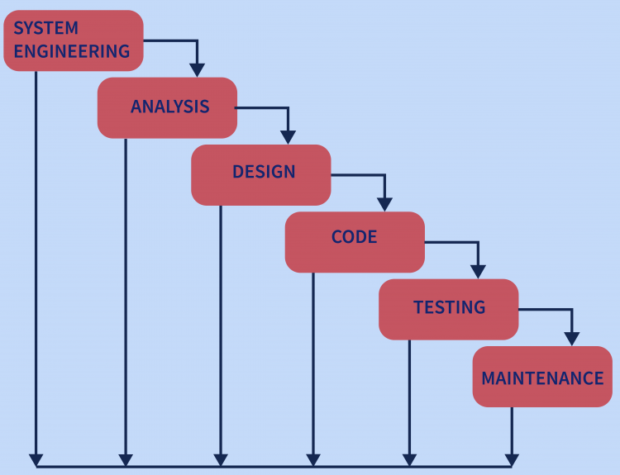
Detailed/Advanced COCOMO Model
The model accounts for the influence of the individual development phase (analysis, design, etc.) of the project.
It uses multipliers for each phase of the project. It gives more accurate estimations
The whole software is divided into different modules and then we apply COCOMO in different modules to estimate effort and then sum the effort.
For instance, detailed COCOMO will perform cost estimation in each development phase of the Waterfall Model

Slide 56
Detailed/Advanced COCOMO Model
In the Detailed COCOMO Model, the cost of each subsystem is estimated separately. This approach reduces the margin of error in the final estimate.
Example: A distributed Management Information System (MIS) product for an organization having offices at several places across the country can have the following sub-components:
Database part
Graphical User Interface (GUI) part
Communication part
Of these, the communication part can be considered as Embedded software. The database part could be Semi-detached software, and the GUI part Organic software.
The costs for these three components can be estimated separately, and summed up to give the overall cost of the system

